Slide 1
GPU Overclocker
By: Sajeeb Chowdhury
& Caleb Maranian

Slide 2
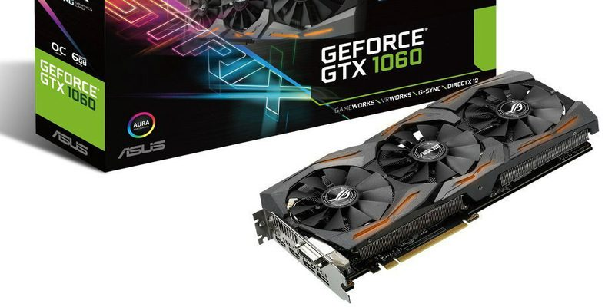
What is a GPU Overclocker?
GPU - Graphics Processing Unit
Pushes a GPU to its limit in order to increase performance
GPU consumes more power and can shorten its lifespan if done improperly
Linux lacks good overclocking programs from trusted providers

Slide 3
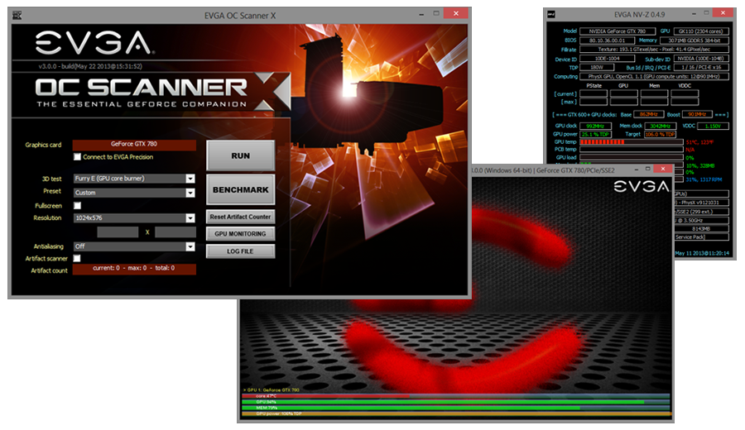
OC Scanner
Runs clock speed tests at a range of voltages to find the exact voltage-frequency value for stability
Currently implemented in Windows automatic overclocking utilities such as EVGA Precision X1 and MSI After Burner.

Slide 4
Problem Characterization
There is no automatic overclocking utility under Linux.
The OC Scanner algorithm cannot be used since it requires the modification of core voltage.
NVIDIA does not allow Linux to modify the power requirements: power limit and core voltage offsets
Linux users wanting to overclock GPUs have to do it manually by guessing a range of core and memory frequency offsets.
This process is tedious.

Slide 5
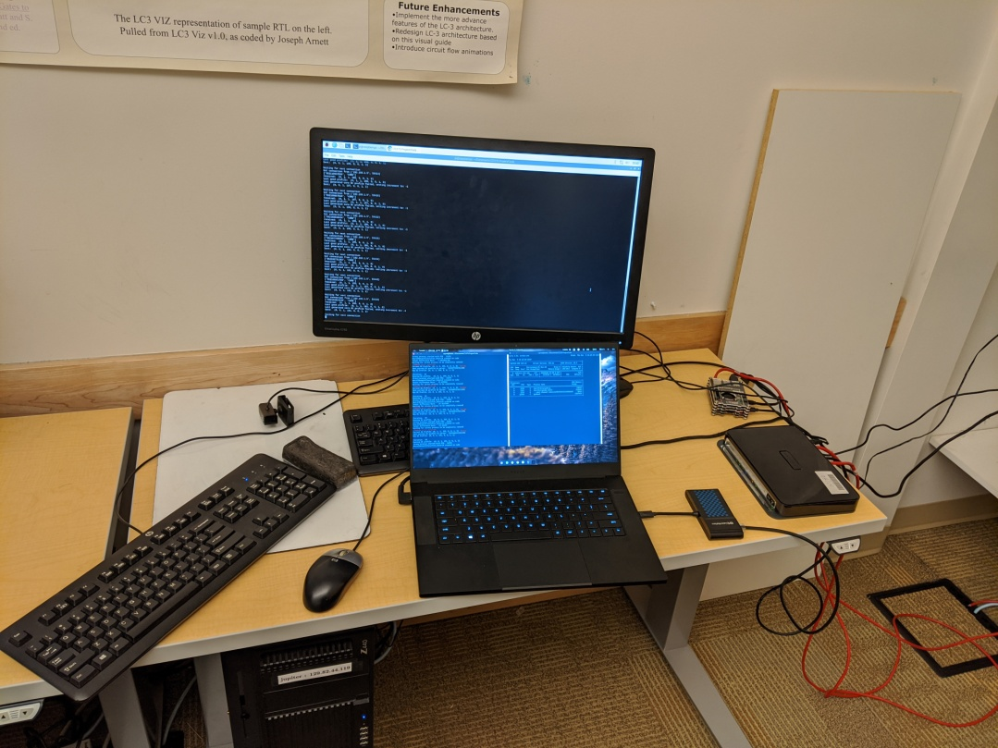
Proposed Solution
We propose to develop an automatic overclocking algorithm for Linux using a Raspberry PI. Current setup is shown below
Our algorithm applies a range of core clock and memory clock offsets and checks the stability of the system after application of each offset

Slide 6
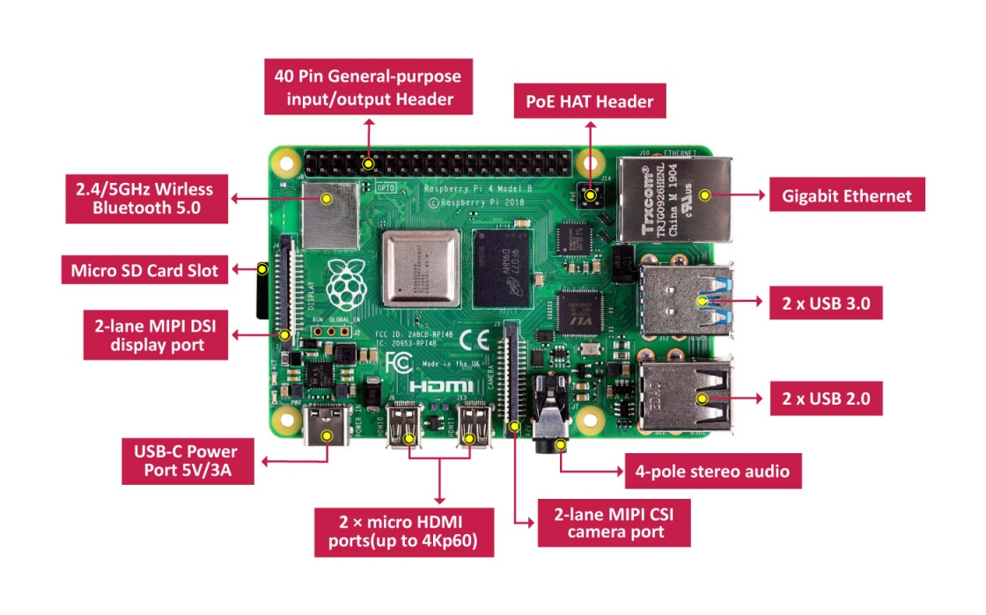
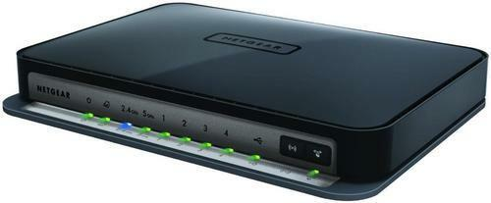
Hardware Requirements
Raspberry PI 4 to run the server portion of the algorithm
Router/Switch to connect the PI to the machine with the GPU

Slide 7
Components of Our Algorithm
Our algorithm is composed of two parts:
The part that is on the client and the part that is on the server
The server part is the core of the algorithm and is further divided into two more components:
Max Offset Finder: Find the maximum offset that can be applied to the GPU without compromising stability or accuracy.
Stabilizer: After finding the max offset make sure that the offset is stable and accurate, else find another offset.

Slide 8
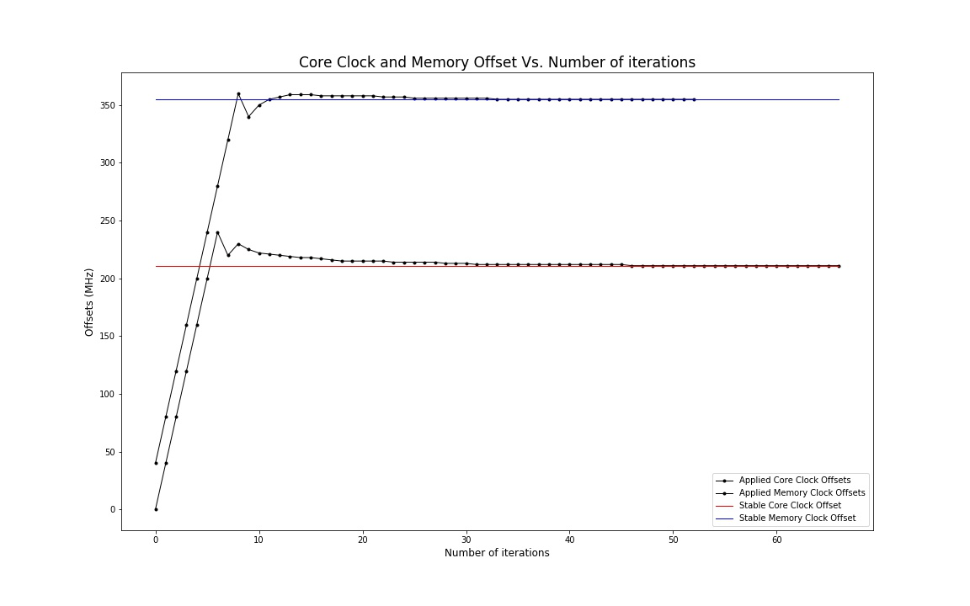
Graph of our algorithm applying OC profiles
Max Offset Finder
Stabilizer

Slide 9
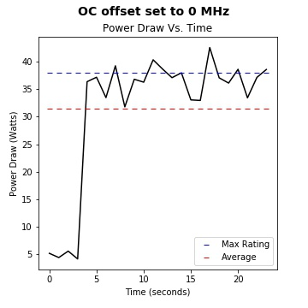
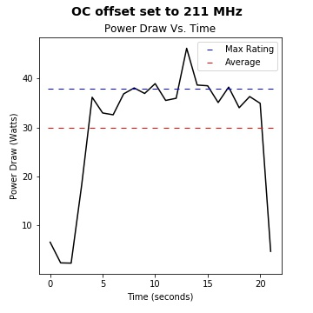
Power Consumption of overclocked GPU
Power Consumption after applying 211MHz offset
Our algorithm was able to increase the core clock speed by 211MHz without modifying voltages or increasing power consumption.

Slide 10
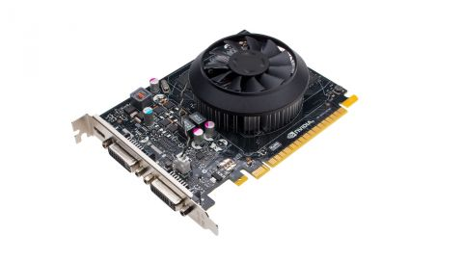
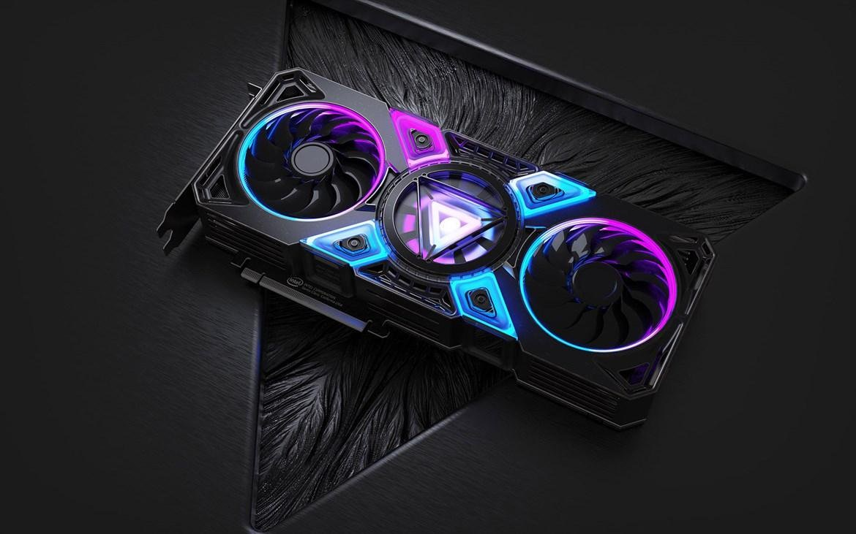
Conclusions
With our algorithm...
750 Ti core clock frequency was raised by 211MHz
750 Ti memory clock frequency was raised by 650MHz
All of these were done without increasing power consumption

Slide 11
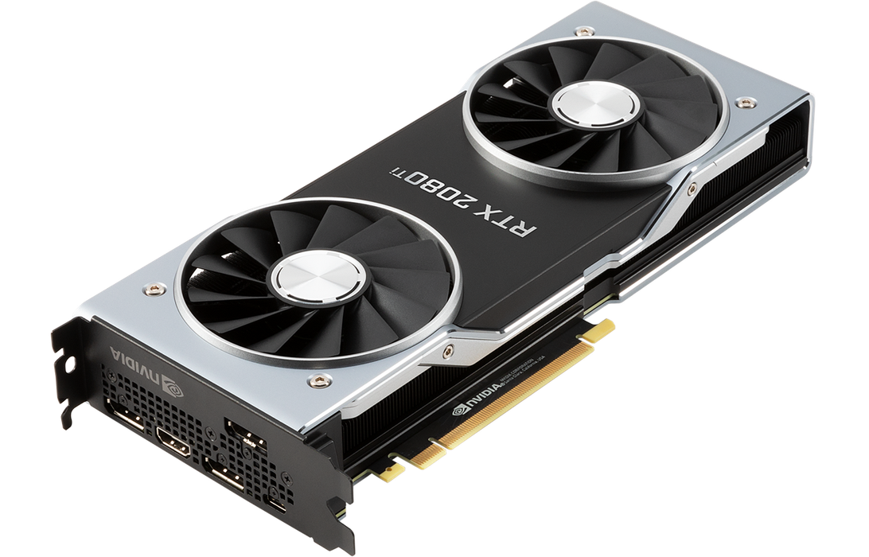
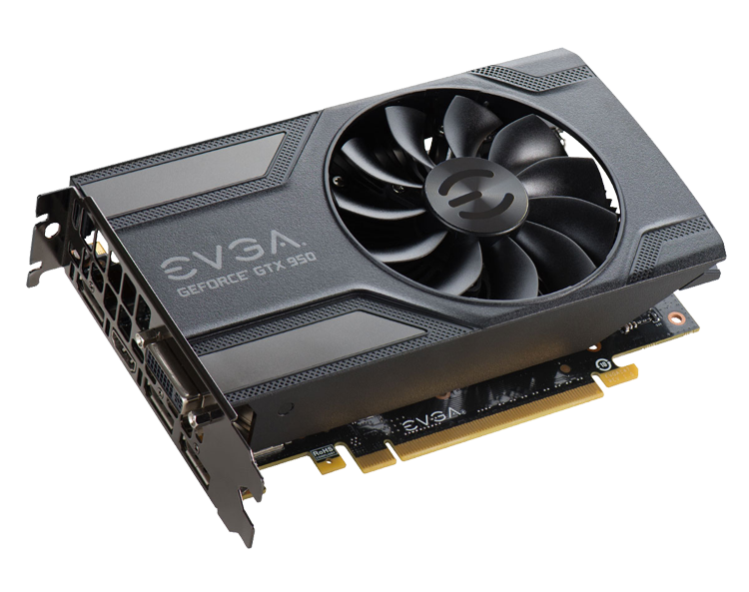
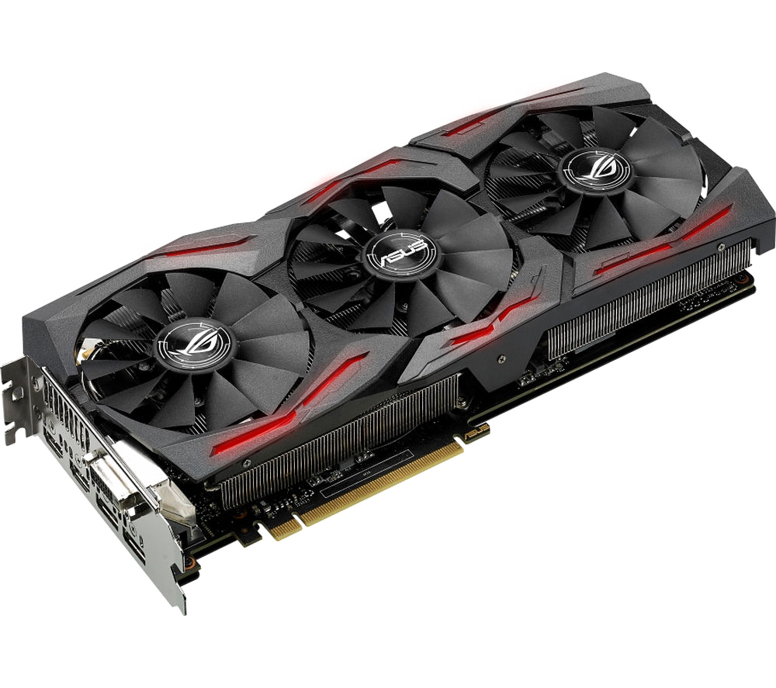
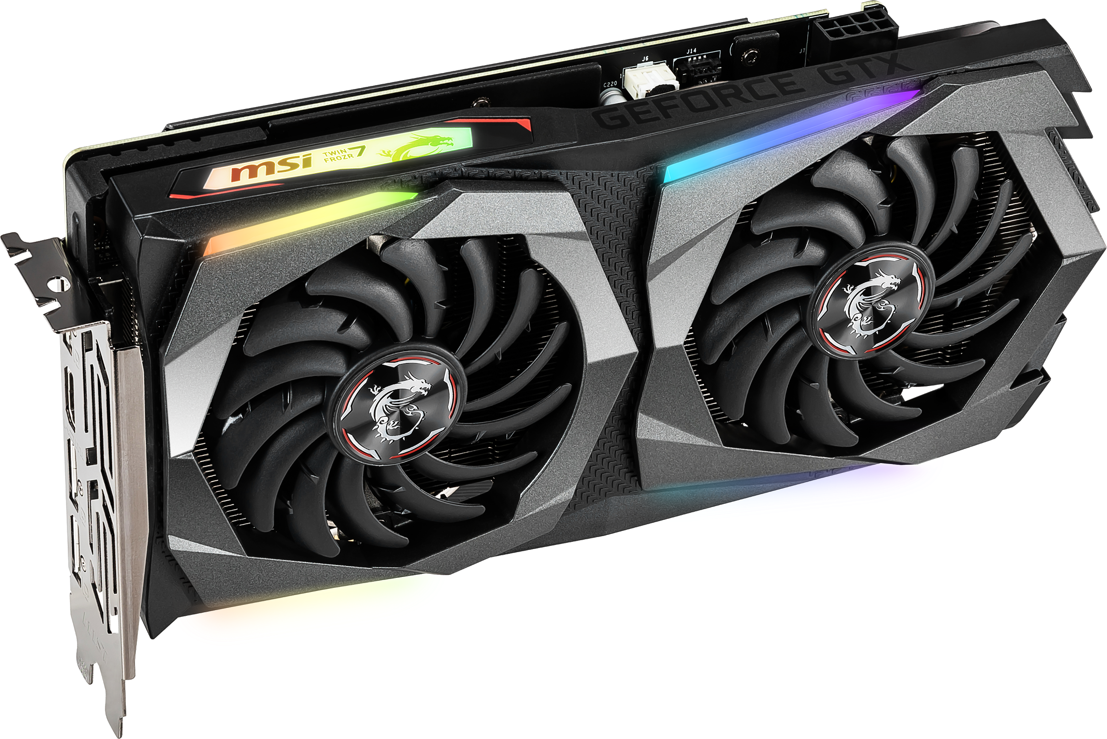
Thank You!

